Slide 1
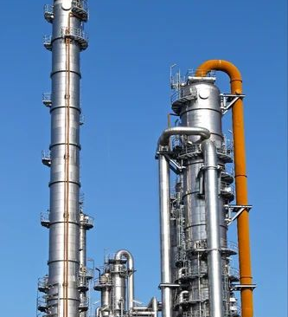
Continuous Distillation
4/21/2026
Joshua Olusoji
Omar Zaruk
Qussay Suleiman
Sanad Abu Hweij

Slide 2
What is Distillation?
• Separation based on boiling point (volatility) differences
• Vapor–liquid contact across trays or packing
• Continuous operation (industrial) vs batch (lab-scale)
• Products removed as distillate (top) and bottoms (bottom)
Koch Modular Process Systems. “Distillation Equipment & Process Systems.”
Accessed April 19, 2026. https://kochmodular.com/distillation/.

Slide 3
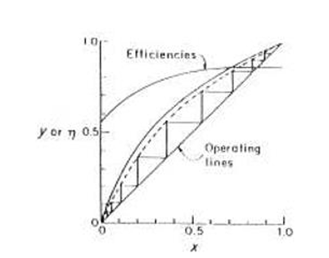
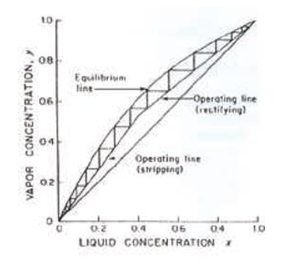
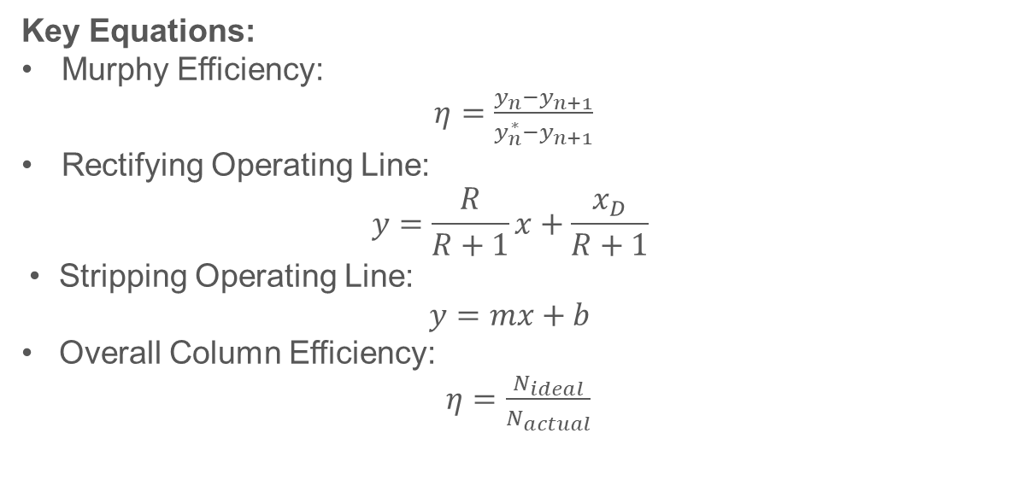
Theory
Key Equations:
Murphy Efficiency:
$η=\frac{y_{n}−y_{n+1}}{y_{n}^{∗}−y_{n+1}}$
Rectifying Operating Line:
$$y=\frac{R}{R+1}x+\frac{x_{D}}{R+1}$$
• Stripping Operating Line:
$$y=mx+b$$
• Overall Column Efficiency:
$η=\frac{N_{ideal}}{N_{actual}}$
Physical Meaning:
• Higher reflux ratio (R) → better separation, higher energy • More stages (N) → improved separation • Efficiency < 1 → real columns require more trays
Department of Chemical Engineering. Continuous Distillation. University of Illinois at Chicago, 2026.
Notes:
feed operating line is constant (vertical line) at feed composition

Slide 4
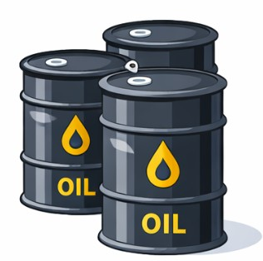
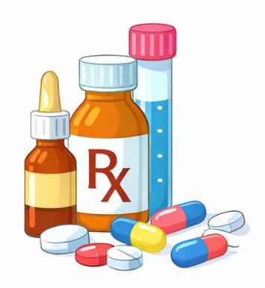
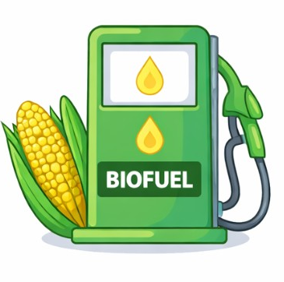
Industrial Applications
Oil refining
Biofuel production
Chemical purification
Separates crude oil into multiple products based on boiling ranges
Used to recover and purify ethanol from fermentation mixtures
Used for solvent recovery, drying, and high-purity product separation

Slide 5
Experimental Objectives
• Determine distillate and bottoms compositions for different feed locations
• Construct McCabe–Thiele diagrams to analyze stage-wise separation
• Estimate number of theoretical stages required for separation and calculate efficiency
• Compare separation performance between middle-feed and top-feed setups
Bonfanti, Luca. “Animated Vacuum Distillation Column.”
Created 2014. Wikimedia Commons.
https://commons.wikimedia.org/.

Slide 6
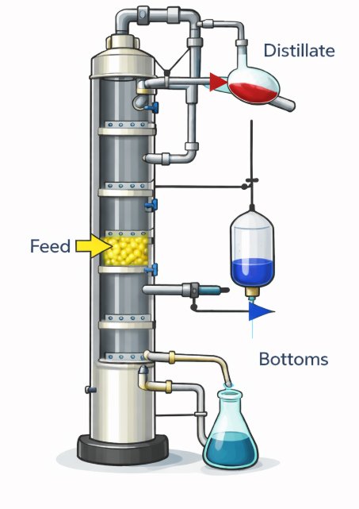
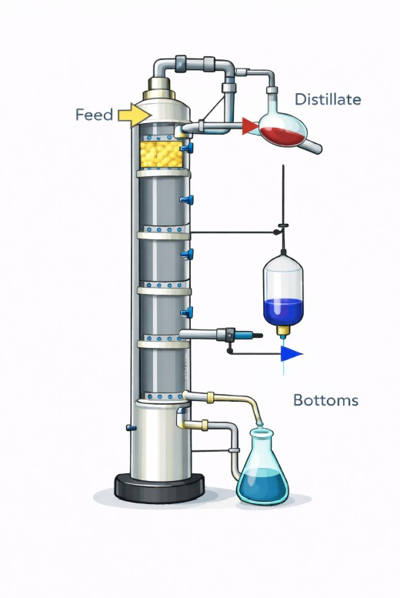
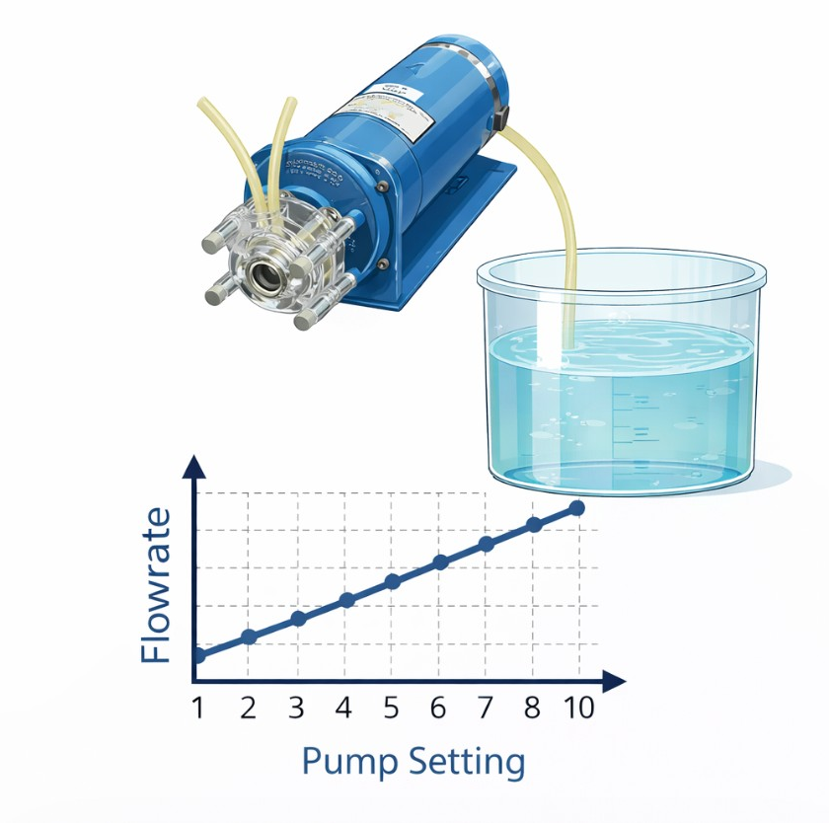
Outline of the Experiments
Experiment B:
Steady State Distillation
Experiment A:
Feed Pump Calibration
A continuous distillation column was operated at steady state to separate an ethanol–water mixture, with the feed introduced at the middle of the column. After steady state was reached, distillate and bottoms flowrates and compositions, along with temperature profiles, were measured to evaluate separation performance.
Experiment C:
Varying Feed Position
The feed pump was calibrated by varying the pump setting and measuring the corresponding flowrate using water. The collected volume over time was used to develop a relationship between pump setting and actual flowrate.
The steady-state distillation experiment was repeated with the feed introduced at the top of the column instead of the middle. The resulting changes in product compositions were analyzed to assess the effect of feed location on separation efficiency.

Slide 7
Column Temperature Behavior (Experiments B & C)
Initial tray temperatures were 20–25 °C
Rapid temperature increase occurred at 30 min when continuous operation began
Steady-state conditions reached at 43 min
Temperatures remained stable afterward, indicating consistent column operation
Column initially operated near steady temperatures 75-90 °C
Stable operation maintained during most of the experiment
Temperature decrease began at 40 min
Cooling indicates reduction in vapor flow and system shutdown

Slide 8
McCabe–Thiele Results and Separation Performance
Feed Position | x_{D} (Distillate) | x_{B} (Bottoms) | Theoretical Stages | Efficiency
Middle Feed | 0.76 | 0.038 | 5.6 | 70%
Top Feed | 0.65 | 0.041 | 3.0 | 38%
Middle feed configuration showed higher purity and efficiency!

Slide 9
Discussion of Results
System exhibits a well-controlled feed rate
Startup temperature gradient represent the columns dynamic behavior approaching S.S.
Demonstrates the relationship between peristaltic pump flow and rotational frequency
Linear decrease across columns at shutdown demonstrates that the column ran at S.S.
Experiment A calibration supports downstream results
Behavior consistent with theory and supports proper column operation

Slide 10
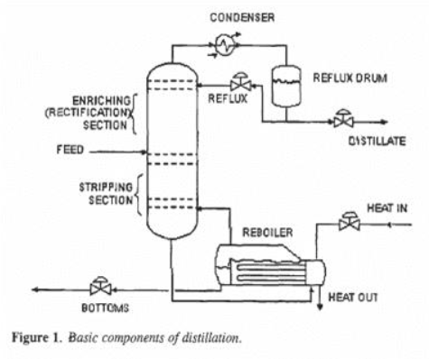
Discussion of Results
Middle Feed provided the best separation.
Perry’s Handbook places efficiency of ethanol-water columns from 50-80%
Theory supports placing the feed near the center – where conc. of feed is similar to the internal conc.
70% lies within this range, validating our results to theory and reality
Top feed location made rectifying section less efficient, reducing the extent of enrichment in the distillate.
Upper range efficiency not reached due to pilot-scale operations, heat loss, and non-equilibrium stages

Slide 11
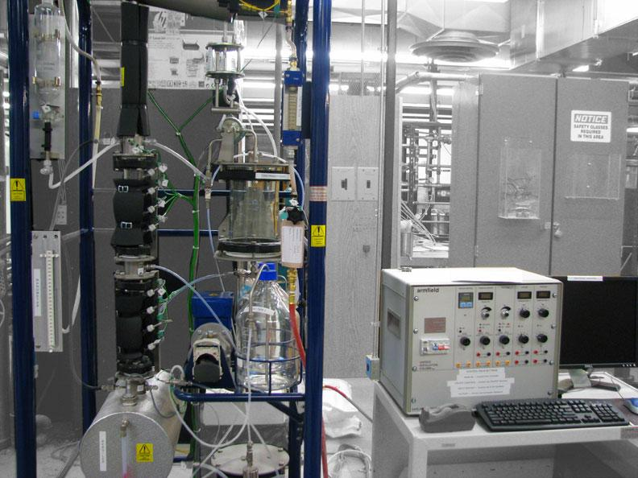
Conclusions
The column reached steady-state and successfully separated the ethanol–water mixture
Feed location had a clear effect on performance
Middle feed gave better separation
Top feed gave lower efficiency
The experimental results were not perfectly ideal
Overall, the results followed expected distillation behavior

Slide 12
References
[1] Department of Chemical Engineering. Continuous Distillation. University of Illinois at Chicago, 2026.
[2] C. J. King, Separation Processes, 2nd ed. McGraw-Hill, 1980.
[3] J. Kunesh, H. Kister, and et al., “Distillation: Still towering over other options,” Chemical Engineering Progress, vol. 89, p. 43, 1995.
[4] W. McCabe, J. Smith, and P. Harriott, Unit Operations of Chemical Engineering, 7th ed. McGraw-Hill, 2005.
[5] R. H. Perry and D. W. Green, Eds., Perry’s Chemical Engineer’s Handbook, 7th ed. McGraw-Hill, 1997.
[6] P. C. Wankat, Equilibrium-Staged Separations. Prentice Hall, 1988.

Slide 13
Thank You!
Any Questions?

